Slide 1
DIKSHA
Your inspection partner

Slide 2
Introduction
We have developed an android app which does both efficiently and in a cost effective way. We are proposing a web and android mobile based school inspection app named DIKSHA for helping the district education department to improve the administration capabilities for monitoring the progress of the primary schools as well as monitoring the inspection activities of the school inspectors.
.

Slide 3
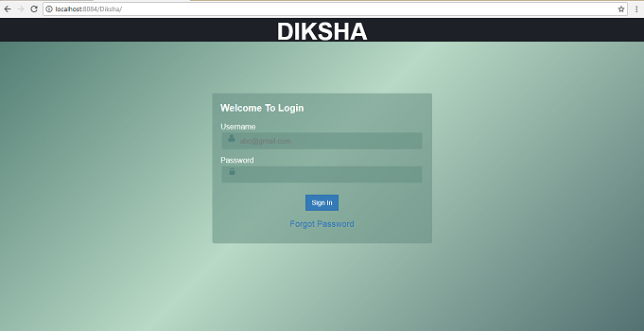
Admin Section
Admin Login panel.

